Slide 1
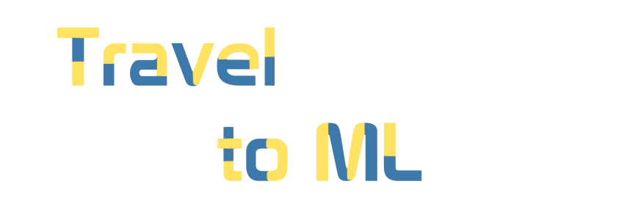
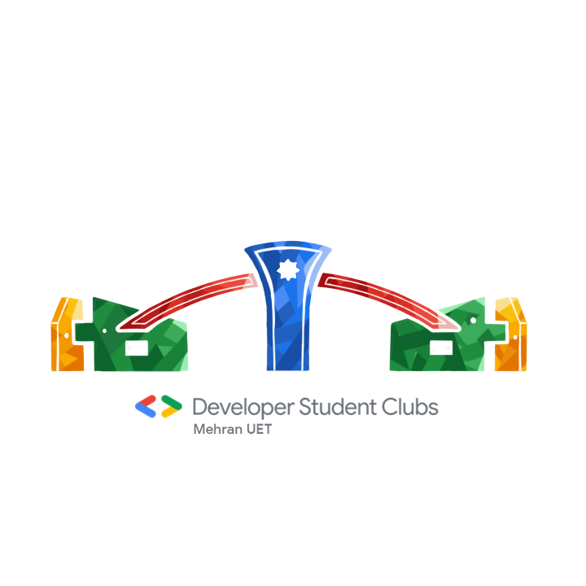
DAY 01 : Python Basics

Slide 2
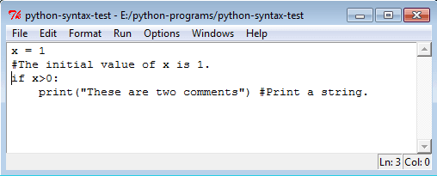

How will you tell the computer to do something?

Slide 3
INTRODUCTION TO PYTHON (1989 or 1991) by GUIDO VAN ROSSUM
IT iS INTERPRETED OBJECT ORIENTED PROGRAMMING LANGUAGE
-FASTEST GROWING LANGUAGE
Also called as GENERAL PURPOSE LANGUAGE

Slide 4
Why we use python?
EASY TO LEARN
MODULES TO MAKE THINGS CLEAR A LOT CLEAR
USED FOR 1. Web Testing 2. Data Extraction 3. Artificial Intelligence (AI) and Data Science Researches 4. Web Application and Internet Development 5. Database Easy Access, Interface Customization, and Quick System Integration 6. Cybersecurity

Slide 5
INSTALLATION
FOLLOW THE INSTRUCTIONS
-https://www.python.org/downloads/

Slide 6
LET’S WRITE SOME CODE!

Slide 7
PYTHON BASICS
you might think these concepts seem arcane and tedious, but with some knowledge and practice, you’ll be able to command your computer like a magic wand to perform incredible feats

Slide 8
AFTER INSTALLING PYTHON
STEP01 : Go to the StarMenu option and search idle
STEP02 : Open it and now we are in python environment where you will be give command to python to do something.
STEP03: You will write some instructions which are called in programs in programming world

Slide 9
PRINT FUNCTION
Please do not get confused it you do not understand this concept yet.
Function is what a set of instruction in-closed in such a way that it can be reused anywhere is the program!
Some functions are called built-in Functions. And print is one of them.
For example: if you want your computer to print something on the screen/console. THE QUESTION IS HOW WILL YOU DO IT? Fortunately, the print function will do the job for us and all it will ask what you want to be printed.

Slide 10
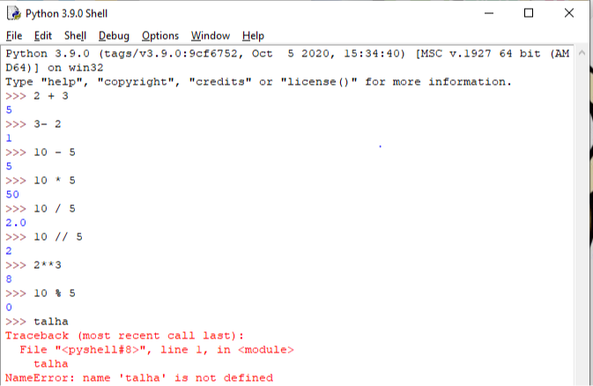
OOPs You got error ☹

Slide 11
Don’t Worry
In programming you will face issues like you have seen in the previous slides
Now, Question is why i got an error.
Just like we humans use grammer to communicate with each other.
Just like that, Python has it’s own way of writing a code.
It is called SYNTAX .

Slide 12
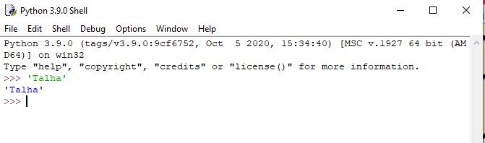
Now, you can see, it actually works . Go back and try with double Quotes and see if it works

Slide 13
Remember, when we doing arithmetic operations and python was giving us the output.
But when if write python to display a text(string) on the screen you use “ ” double quotes or ‘ ’. Depends on your preferences
Let’s go back and write the same text will use double quotes.

Slide 14
Most escape characters used in Python
\’ => Escape colon
\\ => BLACKSLASH
\n => NEW LINE
\t => TAB

Slide 15
OTHER BUILT-IN FUNCTIONS
Type() => returns the type of the specified object
Int() => converts to integer value
Float() => convert to float value
List() = > convert to list type
Tuple() = > converts to tuple type.
Len() = > counts the numbers of characters in string or values in list or tuples.

Slide 16
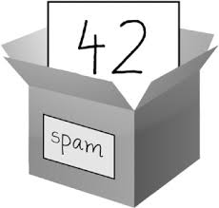
VARIABLES- Why do we need one?
It must be puzzling you all that what is variable?
Imagine a container( a box ) and you put let’s say pencil inside .
Now, box is a variable that contains a value pencil
(IMAGINE THIS)

Slide 17
String
A variable can have string as well.
As we have already introduced text which it is string. You would all notice that “ A TEXT IS SUM OF CHARACTERS ”
Len() => returns the number of characters inside a string.

Slide 18
SLICING
We can slice the string as well.
To slice means = > making a sub string

Slide 19
REFERENCES BOOKS
AUTOMATING THE BORING STUFF – FOR BEGINNERS
Python Crash course – For beginners
WEBSITES
Python docs
TUTORIALSPOINT/PROGRAMMIZ many others as well.

Slide 20
BOOLEAN VALUES
While the integer, floating-point, and string data types have an unlimited number of possible values, the Boolean data type has only two values: True and False.

Slide 21
COMPARISION OPERATORS
Comparison Operators Comparison operators compare two values and evaluate down to a single Boolean value.
== Equal to
!= Not equal to
> Less than
< Greater than
<= Less than or equal to
>= Greater than or equal to

Slide 22
Boolean Operators
The three Boolean operators (and, or, and not) are used to compare Boolean values.
Like comparison operators, they evaluate these expressions down to a Boolean value.
AND TRUTH TABLE
Expression Evaluates to…
True and True = True
True and False = False
False and True = False
False and False = False

Slide 23
OR OPERATOR TRUTH TABLE
True or True = True
True or False = True
False or True = True
False or False = False

Slide 24
NOT OPERATOR
not True = False
not False = True

Slide 25
FLOW CONTROL
Consider that you are making a program to find the larger number!
You can not find through running your statements line by line.
Sometimes, you just want to give some more logic to the python to work onto, imagine making it more intelligent!
Here comes the if statements

Slide 26
IF - ELSE STATEMENTS
Flow control statements often start with a part called the condition, and all are followed by a block of code called the clause.
If condition:
Block of code
Block of code
Block of code (Clause)
Else:
Block of code

Slide 27
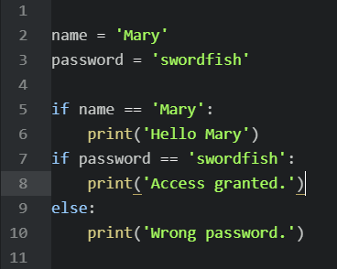
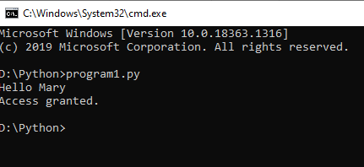

Slide 28
If elif statements
While only one of the if or else clauses will execute, you may have a case where you want one of many possible clauses to execute. The elif statement is an “else if” statement that always follows an if or another elif statement. It provides another condition that is checked only if any of the previous conditions were False. In code, an elif statement always consists of the following:
• The elif keyword • A condition (that is, an expression that evaluates to True or False)
• A colon
• Starting on the next line, an indented block of code (called the elif clause)

Slide 29
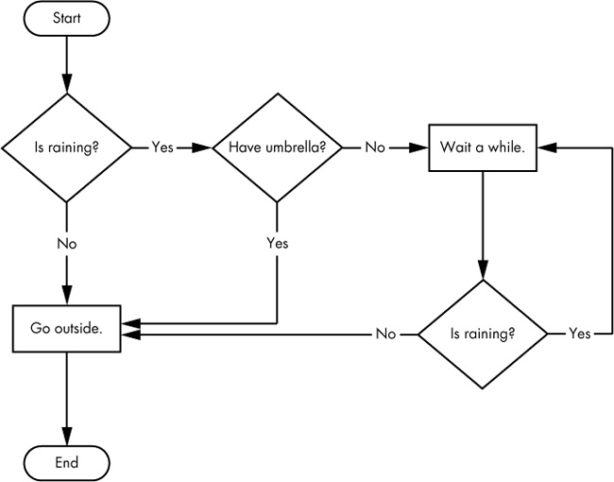

Slide 30
WHILE LOOP STATEMENTS IN PYTHON
You can make a block of code execute over and over again with a while statement. The code in a while clause will be executed as long as the while statement’s condition is True. In code, a while statement always consists of the following:
• The while keyword
• A condition (that is, an expression that evaluates to True or False)
• A colon
• Starting on the next line, an indented block of code (called the while clause)
Increment

Slide 31
FOR LOOPS
The while loop keeps looping while its condition is True (which is the reason for its name), but what if you want to execute a block of code only a certain number of times? You can do this with a for loop statement and the range() function.
• The for keyword
• A variable name
• The in keyword
• A call to the range() method with up to three integers passed to it • A colon
• Starting on the next line, an indented block of code (called the for clause)

